Slide 1


ENV 103
Biomes
Major varieties of world ecosystems

Slide 2
Biomes are climatically and geographically defined as similar climatic conditions on the Earth, such as communities of plants, animals, and soil organisms, and are often referred to as ecosystems. Some parts of the earth have more or less the same kind of abiotic and biotic factors spread over a large area creating a typical ecosystem over that area. Such major ecosystems are termed as biomes. Biomes are defined by factors such as plant structures (such as trees, shrubs, and grasses), leaf types (such as broadleaf and needle leaf), plant spacing (forest, woodland, savanna), and climate.

Slide 3
Biomes: ecosystem of life zones, consisting of similar climatic, topographic, soil conditions (abiotic components) and similar biological communities (biotic components).
Defined first by climate zone, then by major plant type.
Temperature and precipitation are most important determinants in biome distribution
Most terrestrial biomes are identified by the dominant plants of their communities.

Slide 4
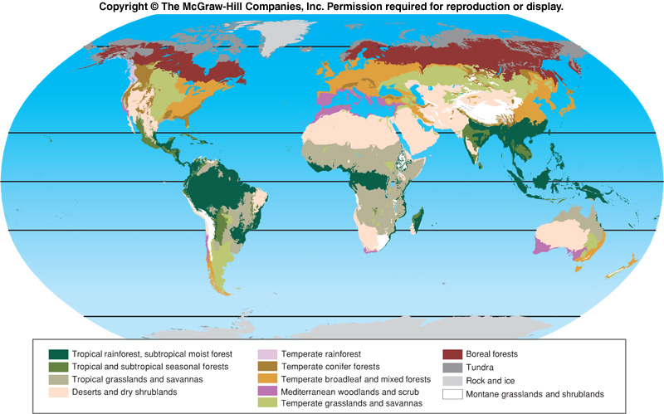
World Biomes

Slide 5
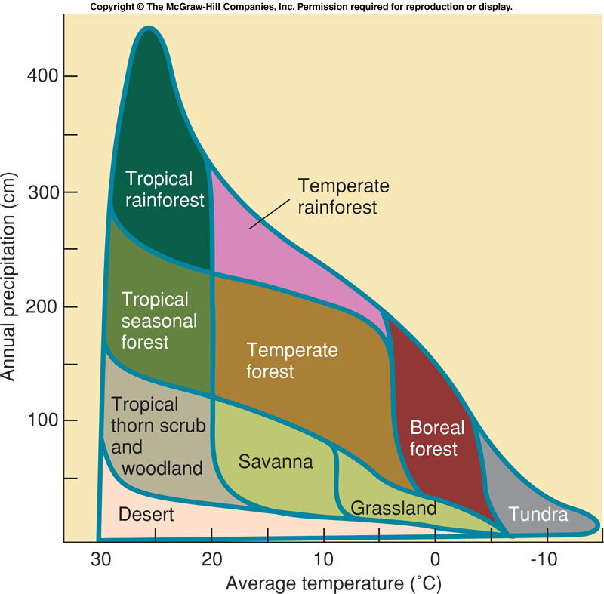
Biomes & Climate

Slide 6
Biomes
Terrestrial
Forest
Tropical
Temperate
Boreal forests (Taiga)
Tundra
Arctic
Alpine
Desert
Grassland
Savannah
Chaparral/Steppe
Aquatic
Marine
Open ocean
Antarctic ocean (edge of the ice)
Estuary
Coral Reef
Shallow ocean/bay
Mangrove forests
Freshwater
River
Lake
Pond
Wetlands (Swamps, marshes, etc.)

Slide 7
Forest
A forest is a community of trees, shrubs, herbs, and associated plants and organisms that cover a considerable area that use oxygen, water and soil nutrients as the community attains maturity and reproduces itself.
Depending on the geographical location, rainfall and temperature, forests contain different types of plant species, ranging from large trees to smallest of weeds.
Based on their locations, forests are classified as
Tropical forest
Temperate forest
Coniferous forest (boreal /taiga)

Slide 8
 | Tropical Forest | Temperate Forest | Coniferous Forest
Location | situated at tropical region of the earth, which is close to equator | occurring between 35⁰ - 65⁰ on either side of the equator | from about 50°N to 70°N latitude
Temperature | Hot and humid climate all the year round, average temperature is 27⁰ C | Average summer temperature is below 10⁰ C, Winter are very cold (-30⁰ C and lower) | Short summer (not particularly warm) about 14⁰ C, Very cold winter (-20⁰ C and lower)
Precipitation | High annual rainfall 2000 mm+; Wet all the year round | Annual precipitation is low (under 300 mm); Precipitation is irregular and falls mostly as snow | Low annual total rainfall (less than 500 mm); Climate experiences extreme changes
Biodiversity | Majority of plant species and large proportion of animal species | Limited compared to tropical forest | More animals than plants
 |  | Temperate forests are of two types – Deciduous forests- present in the northern hemisphere, shed leaves in winter Evergreen forests- present in the southern hemisphere

Slide 9
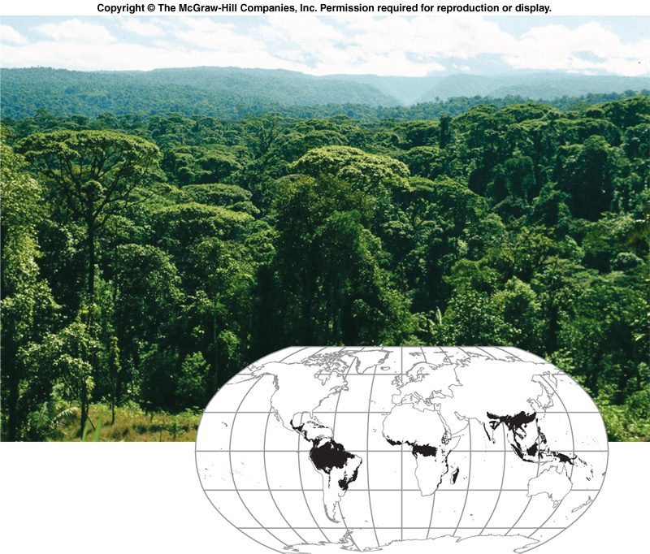
Tropical Rainforest

Slide 10
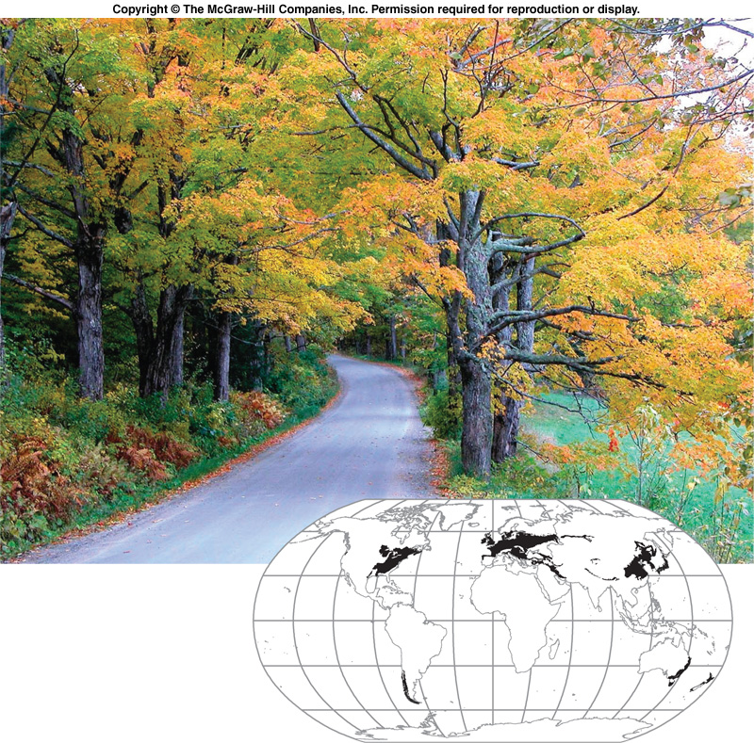
Temperate forest

Slide 11
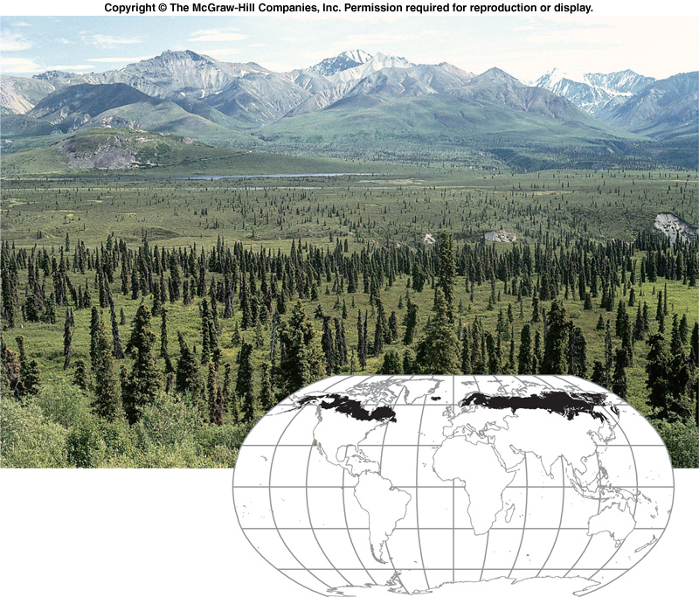
Taiga (Boreal Forest)

Slide 12
Importance of Forest
Watershed
Habitat and Ecosystems
Economic benefits
Climate Control

Slide 13
Deforestation
Clearing forests and woodlands is the most viable way in which people have changed the face of the earth.
Clearing of forests, or intentional destruction or removal of trees and other vegetation for agricultural, commercial, housing, or firewood use without replanting (reforesting) and without allowing time for the forest to regenerate itself. Deforestation is one of the major factors contributing to the greenhouse effect and desertification.

Slide 14
Reasons for deforestation:
Expansion of agricultural and plantation activity for production of food (population increase)
Housing and urbanization
Construction of roads, railway and power transmission lines
Industrial activity
Mining
Cutting wood for different use
Wild grazing by domestic animals
Forest fires
pollution

Slide 15
Effects of Deforestation
Decreased soil fertility from erosion
Runoff of eroded soil into aquatic systems
Loss of habitat for migratory species such as birds and butterflies
Regional climate change from extensive clearing
Release CO₂ into atmosphere from burning and tree decay

Slide 16
Reforestation is the natural or intentional restocking of existing forests and woodlands that have been depleted, usually through deforestation.
The term reforestation is similar to afforestation, the process of restoring and recreating areas of woodlands or forests that may have existed long ago but were deforested or otherwise removed at some point in the past.
Afforestation is the establishment of a forest or stand of trees in an area where there was no forest.

Slide 17
Sustainable Management of Forest
Steps that can be taken for this purpose:
Avoid major project, roads, railway in forest areas.
Mining activity should be restricted.
Dependence on timber should be reduced.
Wild grazing should be restricted
Commercial wood should be grown and harvested in wetlands so that forest are protected.
Social and cultural organization should be engaged in sustainable management of forest.

Slide 18
Tundra
The word tundra means treeless land. The tundra is simplest biome in terms of species composition and food chains.
Treeless, very short growing season, with cold harsh winters.
Average summer temperature are below 10⁰ C
Winter are very cold (-30⁰ C and lower)
Annual precipitation is low (under 300mm)
Precipitation is irregular and falls mostly as snow.
There are two types of Tundra:
Arctic tundra
Alpine tundra

Slide 19
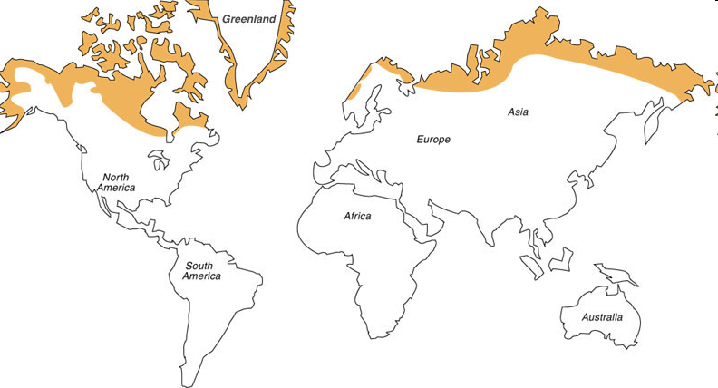
Tundra

Slide 20
Desert
Precipitation is infrequent and unpredictable
Wide daily and seasonal temperature fluctuations.
Often found at 30⁰ N and S of equator
Very dry; hot days, cold nights
Very hot in summer (40⁰ C)
Annual rainfall less than 250mm

Slide 21
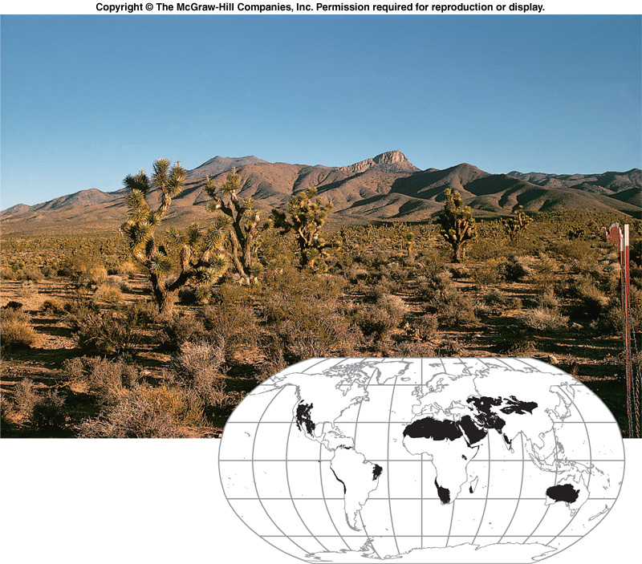
Desert

Slide 22
Grassland
Grasslands are characterized as lands dominated by grasses rather than large shrubs or trees.
The climate is dry, hot and warm.
Annual rainfall is 50-120cm.
There are two main divisions of grasslands:
Tropical (Savanna)
Temperate (North America- Prairie, Eurasia- Steppes/Chaparral)
Savanna is grassland with scattered individual trees.
Temperate grasslands are characterized as having grasses as the dominant vegetation

Slide 23
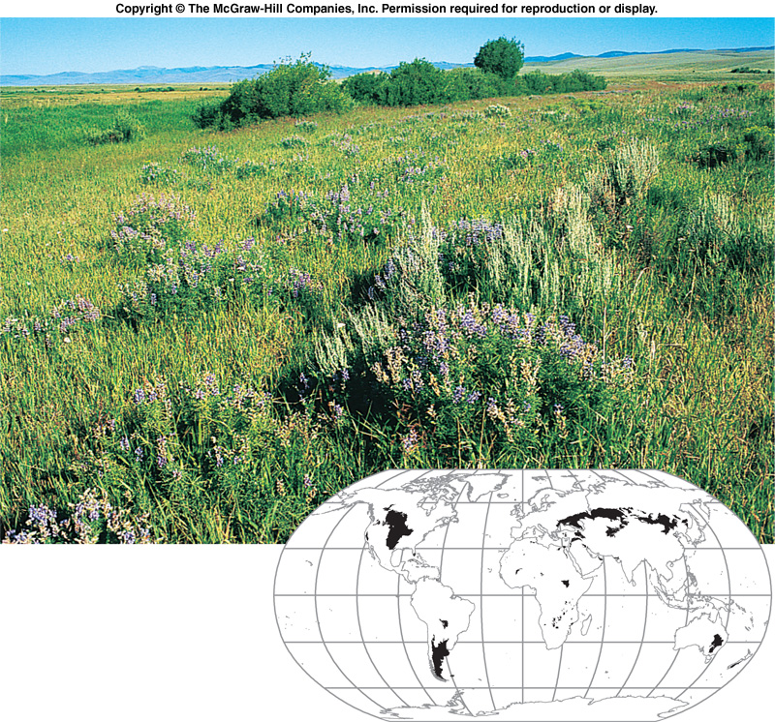
Grassland

Slide 24
Aquatic Biomes
Life on earth is not possible without water regions
75% of the earth’s surface is covered with water
Aquatic regions house numerous species of plants and animals, both large and small
Water temperatures can vary widely.
The aquatic biome can be divided into two :
Fresh water
Marine

Slide 25
PRESERVATION OF BIOME
Biomes have changed and moved many times during the history of life on Earth. More recently, human activities have drastically altered these communities. Thus, conservation and preservation of biomes should be a major concern to all.
Control pollution
Protect forests
Preserve fresh water
By educating people about the consequences of our actions, we can all gain a better understanding of how to preserve the Earth's natural biomes.

Slide 26
THANK YOU

